Slide 1

SENTIMENT MARKER
Presented By –
Shaurya Garg
B.TechIBM
TCA2357049

Slide 2
INTRODUCTION TO THE PROJECT
The project’s main goal is to use Python to create a sentiment detector application. It uses “tkinter” for the graphical user interface and “vaderSentiment” for sentiment analysis.
Based on the sentiment ratings produced by VADER, this tool is intended to evaluate user-provided text and classify messages as either positive, neutral, or negative based on the wordings in their message.
In addition, it offers sentiment scores and an overall sentiment classification, the graphical user interface facilitates text input. This project can be used to analyze user reviews, social media posts, or other text data in order to gain a clearer understanding of public mood.

Slide 3
KEY FEATURES
Input Text Area - A space where users can enter the sentence they wish to analyze.
Sentiment Analysis - The application uses the VADER (Valence Aware Dictionary and sEntiment Reasoner) sentiment analysis tool to evaluate the input text.
Result Display - It shows the percentage of positive, neutral, and negative sentiments in the text.
Overall Sentiment - Provides an overall rating of the sentiment (Positive, Negative, Neutral).
Clear Function - A button to clear all input and output fields.
Exit- Click the "Exit" button to close the application.

Slide 4
HOW TO USE ?
Setup: Ensure Python is installed on your system along with the vaderSentiment package.
Run the Application: Execute the Python script to open the GUI.
Input Sentence: Enter the sentence you wish to analyze in the text area.
Analyze Sentiment: Click the "Check Sentiment" button to process the input text.
View Results: The application displays the sentiment analysis results in the respective fields.
Clear Input/Output: Use the "Clear" button to reset the input and output fields.
Exit: Click the "Exit" button to close the application.

Slide 5
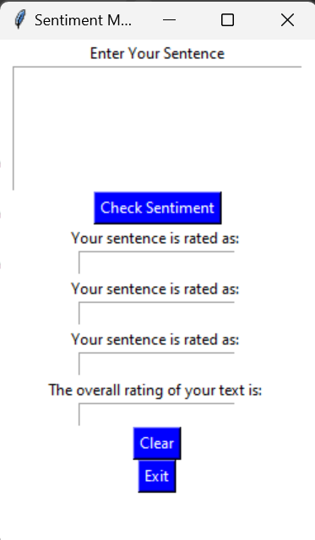
UI SNIPPET

Slide 6

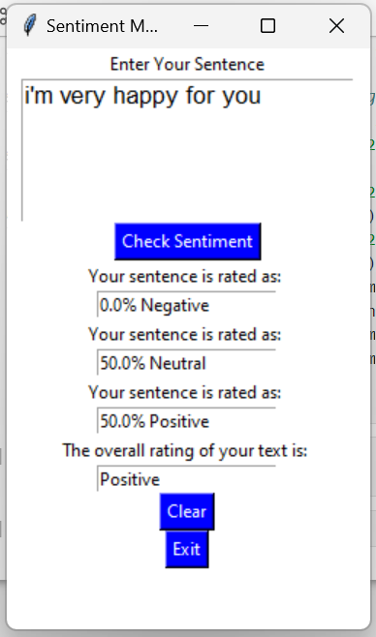
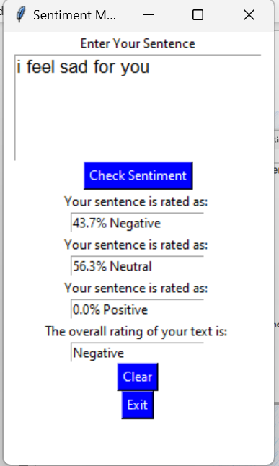
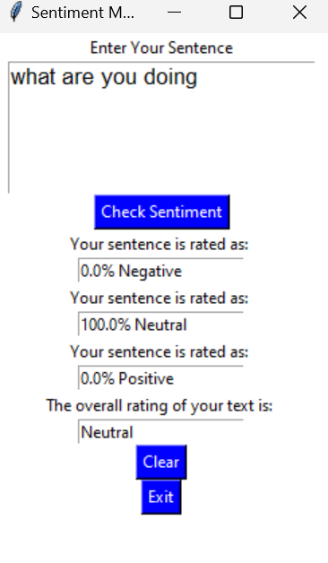
DEMONSTRATION OF PROJECT

Slide 7
HARDWARE AND SOFTWARE REQUIREMNETS
HARDWARE REQUIREMENTS:
Processor: Minimum of a dual-core processor (recommended: Intel Core i3 or higher)
RAM: 4GB (recommended: 8GB or higher for smoother performance)
Storage: At least 500MB of free space for Python libraries and project files
Operating System: Windows, macOS, or Linux
Display: A screen resolution of at least 1024x768
Input Devices: Keyboard and mouse/touchpad
SOFTWARE REQUIREMENTS:
Python: Version 3.6 or higher
Libraries: vaderSentiment for sentiment analysis and tkinter for GUI development
IDE/Code Editor (any one of the following):
PyCharm
Visual Studio Code
Jupyter Notebook
IDLE (comes with Python)
Operating System: Compatible with Windows, macOS, or Linux distributions
Internet access: For downloading Python libraries and dependencies

Slide 8
APPLICATIONS AND FUTURE IMPROVEMENTS
Applications:
Quick sentiment analysis for user-generated content (e.g., social media posts, reviews).
Useful tool for educators, businesses, and sentiment researchers.
Future Improvements:
Improve sentiment detection accuracy with additional models or training data.
Enable file input for batch sentiment analysis.
Add language support for non-English text.

Slide 9
THANKYOU

